Slide 1

IT-1201: Data Structures
for
1st Year 2nd Semester of B.Sc (Honors) in IT (5th Batch)
Lecture: 15
Graph-2: Graph Representation
Prepared by:
K M Akkas Ali
akkas_khan@yahoo.com, akkas@juniv.edu
Associate Professor
Institute of Information Technology (IIT)
Jahangirnagar University, Dhaka-1342

Slide 2
Lecture-15:
Graph-2: Graph Representation
Objectives of this Lecture:
  Definition of graphs and related concepts
  Vertices/nodes, edges, adjacency, incidence
  Degree, in-degree, out-degree
  Subgraphs, unions, isomorphism
  Adjacency matrices
  Types of Graphs
  Trees
  Undirected graphs
  Simple graphs, Multigraphs, Pseudographs
  Digraphs, Directed multigraph
  Bipartite
  Complete graphs, cycles, wheels, cubes, complete bipartite
  Representation of Graphs
  Graph Traversal
  Graph Applications

Slide 3
Graph Representations:
For graphs to be computationally useful, they have to be conveniently represented in programs.
There are two computer representations of graphs:
Adjacency Matrix representation
Adjacency Lists representation

Slide 4
Adjacency Matrix Representation
Graph Representations:
In this representation, each graph of n nodes is represented by an n x n matrix A, that is, a two-dimensional array A
The nodes are (re)-labeled 1,2,…,n
A[i][j] = 1 if (i,j) is an edge
A[i][j] = 0 if (i,j) is not an edge
The adjacency matrix for an undirected graph is symmetric; the adjacency matrix for a digraph
need not be symmetric

Slide 5
Example of Adjacency Matrix
Graph Representations:
1
0
0 1 0 1 0
0 0 1 0 0
0 0 1 0 0
1 0 0 0 0
0 0 0 4 0
A =
2
4
3

Slide 6
Another Example of Adj. Matrix
Graph Representations:
Re-label the nodes with numerical labels
Mary 0
Helen 1
0 0 0 0 0 0
0 0 0 0 0 0
1 1 0 0 1 1
1 1 0 0 1 1
1 1 0 0 0 0
1 1 0 0 0 0
A =
Joe 3
John 2
Tom 4
Paul 5

Slide 7
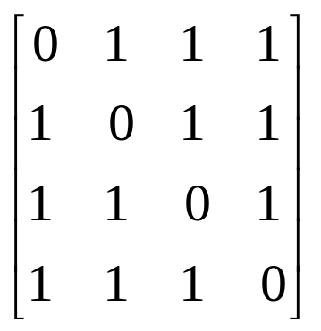
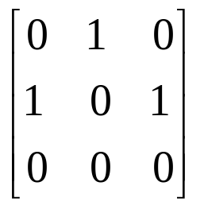
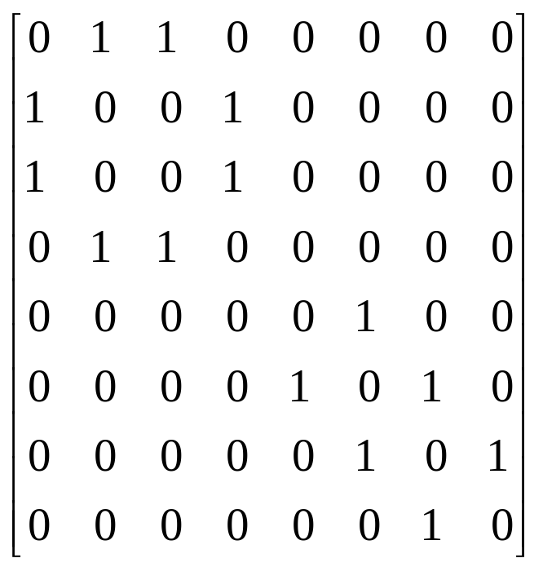
Graph Representations:
Examples for Adjacency Matrix
0
4
0
0
2
1
5
1
2
3
6
3
1
7
2
G2
G1
symmetric
undirected: n²/2
directed: n²
G4

Slide 8
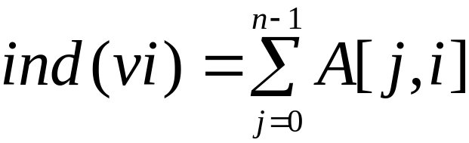
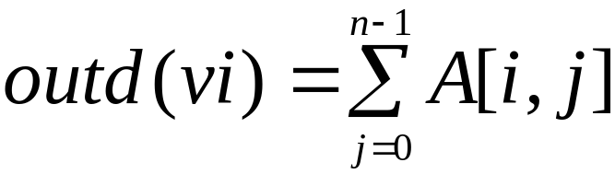
Pros and Cons of Adjacency Matrices
Graph Representations:
Pros:
  From the adjacency matrix, to determine the connection of vertices is easy
  Simple to implement
  Easy and fast to tell if a pair (i,j) is an edge: simply check if A[i][j] is 1 or 0
  For a digraph (= directed graph), the row sum is the out_degree, while the column sum is the in_degree
Cons:
  No matter how few edges the graph has, the matrix takes O(n²) in memory

Slide 9
Graph Representations:
Adjacency Lists Representation
Each row in adjacency matrix is represented as an adjacency list.
A graph of n nodes is represented by a one-dimensional array L of linked lists, where
  L[i] is the linked list containing all the nodes adjacent from node i.
  The nodes in the list L[i] are in no particular order
#define MAX_VERTICES 50
typedef struct node *node_pointer;
typedef struct node {
int vertex;
struct node *link;
};
node_pointer graph[MAX_VERTICES];
int n=0; /* vertices currently in use */

Slide 10
Example of Linked Representation
L[0]: empty
L[1]: empty
L[2]: 0, 1, 4, 5
L[3]: 0, 1, 4, 5
L[4]: 0, 1
L[5]: 0, 1
Mary 0
Helen 1
Joe 3
John 2
Tom 4
Paul 5

Slide 11
Pros and Cons of Adjacency Lists
Pros:
  Saves on space (memory): the representation takes as many memory words as there are nodes and edge.
Cons:
  It can take up to O(n) time to determine if a pair of nodes (i,j) is an edge: one would have to search the linked list L[i], which takes time proportional to the length of L[i].

Slide 12
Graph Representations:
0
0
4
2
1
5
1
2
3
6
3
7
0
1
2
3
1
2
3
0
1
2
3
4
5
6
7
1
2
0
2
3
0
3
0
1
3
0
3
0
1
2
1
2
G1
0
5
4
6
0
1
2
1
5
7
0
2
1
6
G3
G4
2
An undirected graph with n vertices and e edges ==> n head nodes and 2e list nodes

Slide 13
Some Operations on Graph:
degree of a vertex in an undirected graph
  # of nodes in adjacency list
# of edges in a graph
  determined in O(n+e)
out-degree of a vertex in a directed graph
  # of nodes in its adjacency list
in-degree of a vertex in a directed graph
  traverse the whole data structure

Slide 14
Graph Traversal Techniques:
Problem: Search for a certain node or traverse all nodes in the graph
The previous connectivity problem, as well as many other graph problems, can be solved using graph traversal techniques
There are two standard graph traversal techniques:
  Depth-First Search (DFS)
  Breadth-First Search (BFS)
Depth First Search
  Once a possible path is found, continue the search until the end of the path
Breadth First Search
  Start several paths at a time, and advance in each one step at a time
In both DFS and BFS, the nodes of the undirected graph are visited in a systematic manner so that every node is visited exactly one.
Both BFS and DFS give rise to a tree:
  When a node x is visited, it is labeled as visited, and it is added to the tree
  If the traversal got to node x from node y, y is viewed as the parent of x, and x a child of y

Slide 15
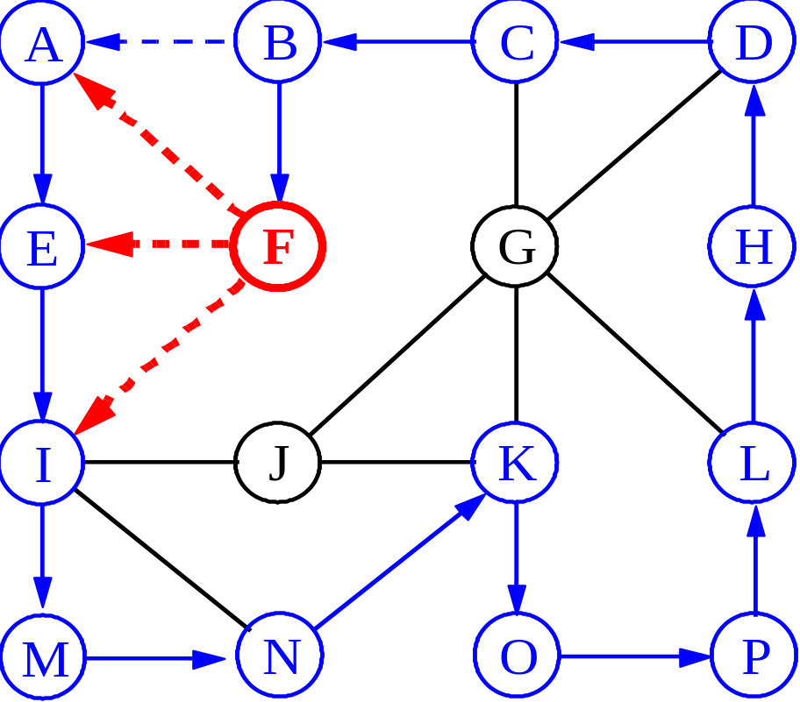
Depth-First Search:

Slide 16
Exploring a Labyrinth Without Getting Lost
Depth-First Search:
A depth-first search (DFS) in an undirected graph G is like wandering in a labyrinth with a string and a can of red paint without getting lost.
We start at vertex s, tying the end of our string to the point and painting s “visited”. Next we label s as our current vertex called u.
Now we travel along an arbitrary edge (u, v).
If edge (u, v) leads us to an already visited vertex v we return to u.
If vertex v is unvisited, we unroll our string and move to v, paint v “visited”, set v as our current vertex, and repeat the previous steps.

Slide 17
Depth-First Search
DFS follows the following rules:
  Select an unvisited node x, visit it, and treat as the current node
  Find an unvisited neighbor of the current node, visit it, and make it the new current node;
  If the current node has no unvisited neighbors, backtrack to the its parent, and make that parent the new current node;
  Repeat steps 3 and 4 until no more nodes can be visited.
  If there are still unvisited nodes, repeat from step 1.

Slide 18
Depth-First Search:
Algorithm DFS(v); Input: A vertex v in a graph
Output: A labeling of the edges as “discovery” edges and “backedges”
for each edge e incident on v do
if edge e is unexplored then let w be the other endpoint of e
if vertex w is unexplored then label e as a discovery edge
recursively call DFS(w)
else label e as a backedge

Slide 19
Illustration of DFS
0
1
0
2
1
4
4
9
10
5
7
2
11
8
5
9
6
7
11
6
Graph G
8
10
DFS Tree

Slide 20
Implementation of DFS
Observations:
  the last node visited is the first node from which to proceed.
  Also, the backtracking proceeds on the basis of "last visited, first to backtrack too".
  This suggests that a stack is the proper data structure to remember the current node and how to backtrack.

Slide 21
Breadth-First Search:
Like DFS, a Breadth-First Search (BFS) traverses a connected component of a graph, and in doing so defines a spanning tree with several useful properties.
The starting vertex s has level 0, and, as in DFS, defines that point as an “anchor.”
In the first round, the string is unrolled the length of one edge, and all of the edges that are only one edge away from the anchor are visited.
These edges are placed into level 1
In the second round, all the new edges that can be reached by unrolling the string 2 edges are visited and placed in level 2.
This continues until every vertex has been assigned a level.
The label of any vertex v corresponds to the length of the shortest path from s to v.

Slide 22
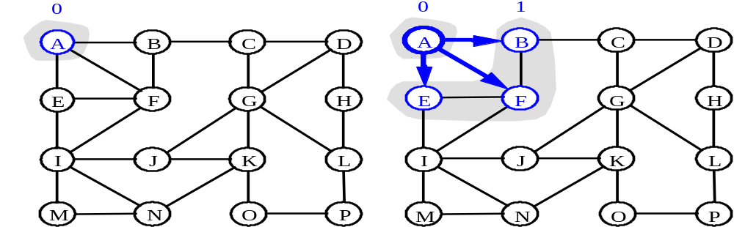
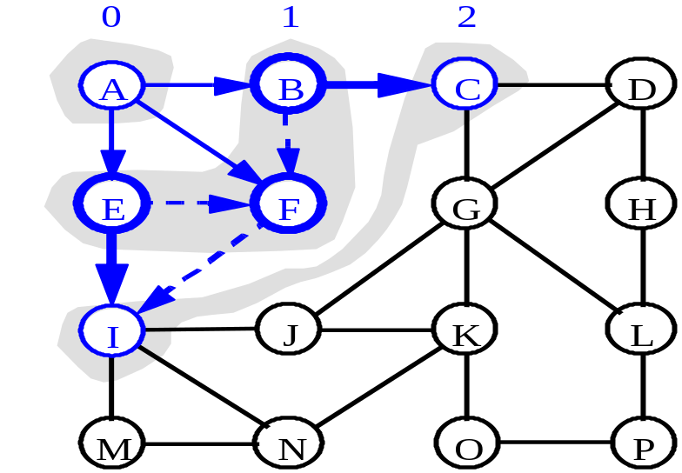
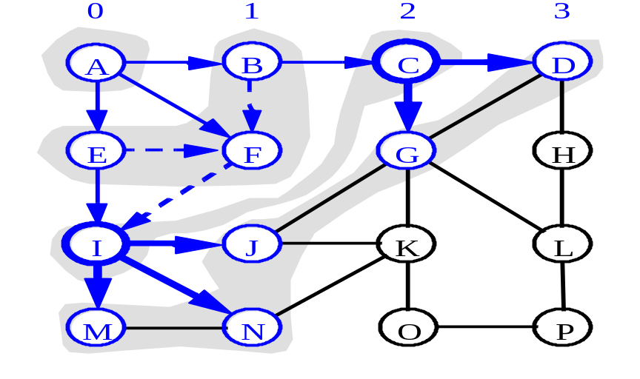
BFS - A Graphical Representation
Breadth-First Search:
a)
b)
c)
d)

Slide 23
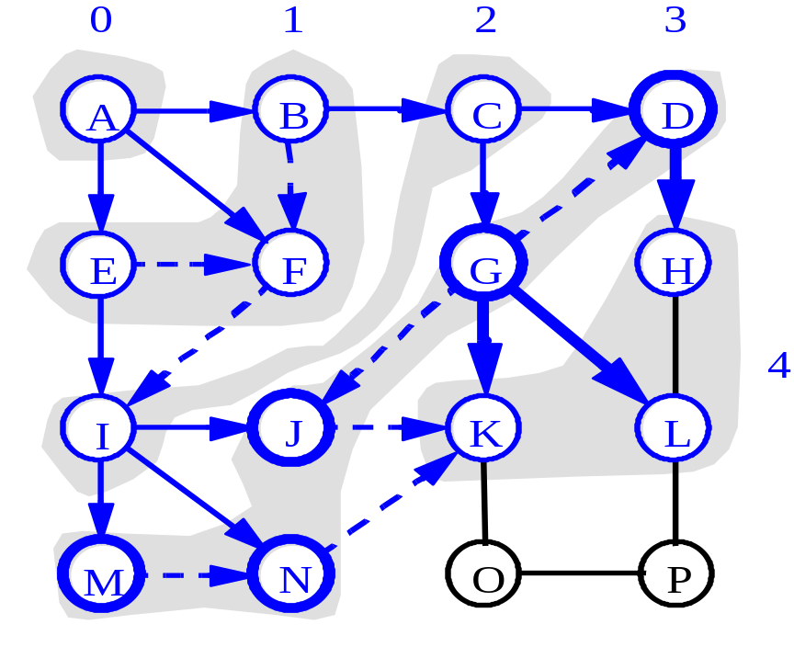
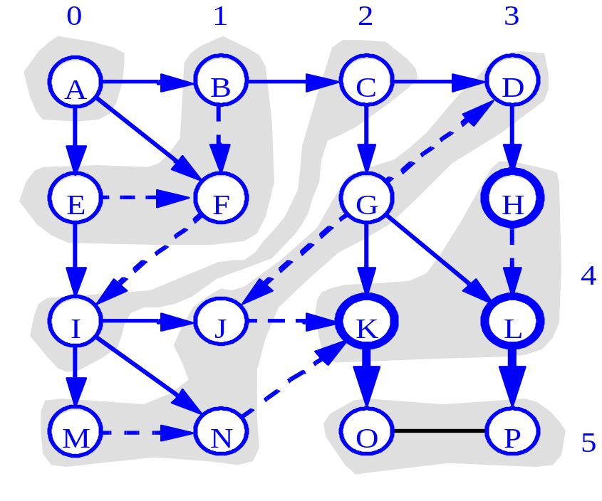
More BFS
Breadth-First Search:

Slide 24
Breadth-First Search
BFS follows the following rules:
  Select an unvisited node x, visit it, have it be the root in a BFS tree being formed. Its level is called the current level.
  From each node z in the current level, in the order in which the level nodes were visited, visit all the unvisited neighbors of z. The newly visited nodes from this level form a new level that becomes the next current level.
  Repeat step 2 until no more nodes can be visited.
  If there are still unvisited nodes, repeat from Step 1.

Slide 25
Illustration of BFS
0
1
0
2
4
2
1
4
9
5
9
10
10
5
7
11
8
6
7
8
11
6
BFS Tree
Graph G

Slide 26
BFS Pseudo-Code
Breadth-First Search:
Algorithm BFS(s): Input: A vertex s in a graph
Output: A labeling of the edges as “discovery” edges and “cross edges”
initialize container L₀ to contain vertex s
i ← 0
while L_{i} is not empty do
create container L_{i+1} to initially be empty
for each vertex v in L_{i} do
if edge e incident on v do
let w be the other endpoint of e
if vertex w is unexplored then
label e as a discovery edge
insert w into L_{i+1}
else label e as a cross edge
i ← i + 1

Slide 27
Applications: Finding a Path
Breadth-First Search:
Find path from source vertex s to destination vertex d
Use graph search starting at s and terminating as soon as we reach d
  Need to remember edges traversed
Use depth – first search ?
Use breath – first search?

Slide 28
DFS vs. BFS
Breadth-First Search Vs. Depth-First Search:
DFS Process
F
B
A
start
E
G
D
C
destination
C
DFS on C
D
Call DFS on D
B
DFS on B
B
B
Return to call on B
A
DFS on A
A
A
A
G
Call DFS on G
found destination - done!
Path is implicitly stored in DFS recursion
Path is: A, B, D, G
D
B
A

Slide 29
DFS vs. BFS
Breadth-First Search Vs. Depth-First Search:
F
B
A
start
E
BFS Process
G
D
C
destination
rear
front
rear
front
rear
front
rear
front
A
B
D
C
D
Initial call to BFS on A
Add A to queue
Dequeue A
Add B
Dequeue B
Add C, D
Dequeue C
Nothing to add
rear
front
G
found destination - done!
Path must be stored separately
Dequeue D
Add G

